Slide 1
Modelo
Matching Network

Slide 2
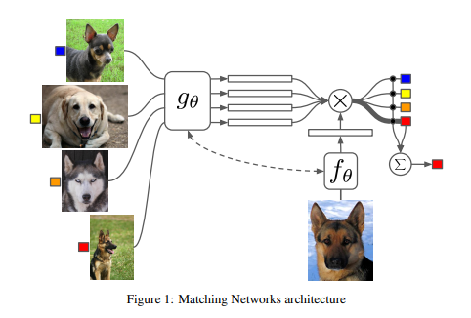
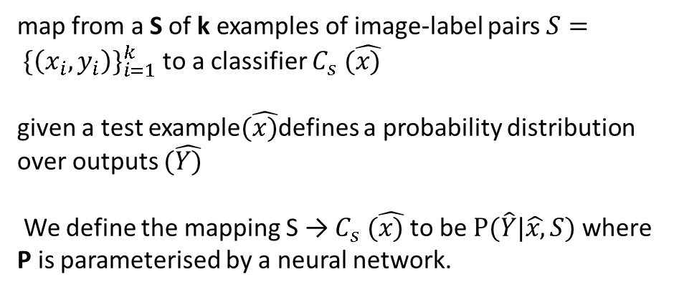
Uses recent advances in NN with augmented memory.
Training procedure is based on simple ML principle: test and train conditions must match (Showing only a few examples per class).
map from a S of k examples of image-label pairs $S= {\{\left(x_{i}, y_{i}\right)\}}_{i=1}^{k}$to a classifier $C_{s} (\hat{x)}$
given a test example$(\hat{x)}$defines a probability distribution over outputs $(\hat{Y)}$
We define the mapping S → $C_{s} (\hat{x)}$to be $P(\hat{Y}|\hat{x,}S)$where P is parameterised by a neural network.
Support set (S)
Query set (S)

Slide 3
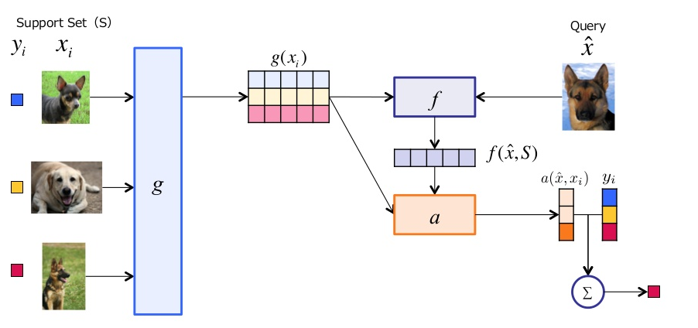

Slide 4
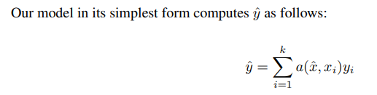
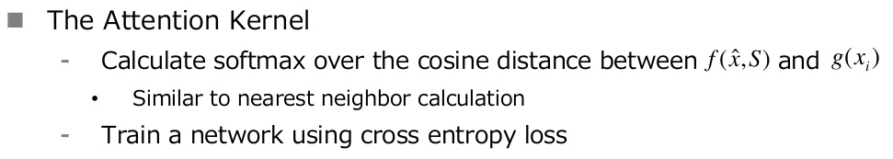
the attention mechanism a is a kernel on X × X, then is akin to a kernel density estimator
describes the output for a new class as a linear combination of the labels in the support set.
embedding functions f and g being appropriate neural networks (potentially with f = g) to embed $\hat{x}$ and $x_{i}$ .

Slide 5
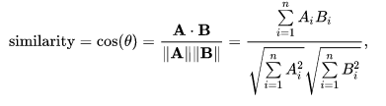
Loss
This kind of loss is also related to methods such as Neighborhood Component Analysis (NCA), triplet loss or large margin nearest neighbor (Investigar).

Slide 6


Full Context Embeddings $f$
a “content” based attention
the softmax g(xi).
The read-out rk−1 from g(S) is concatenated to hk−1.

Slide 7
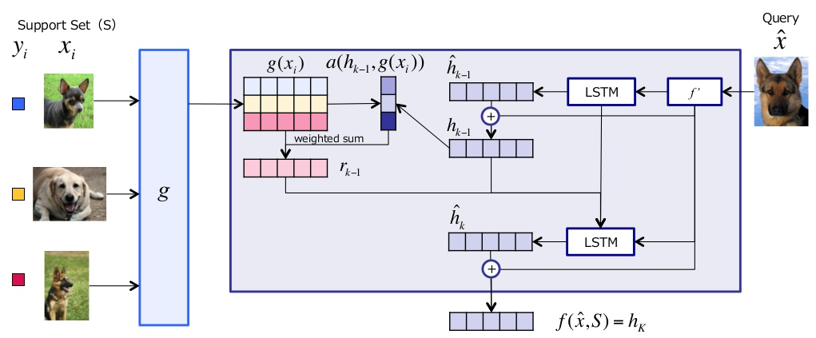
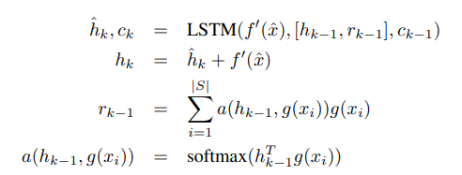

Slide 8
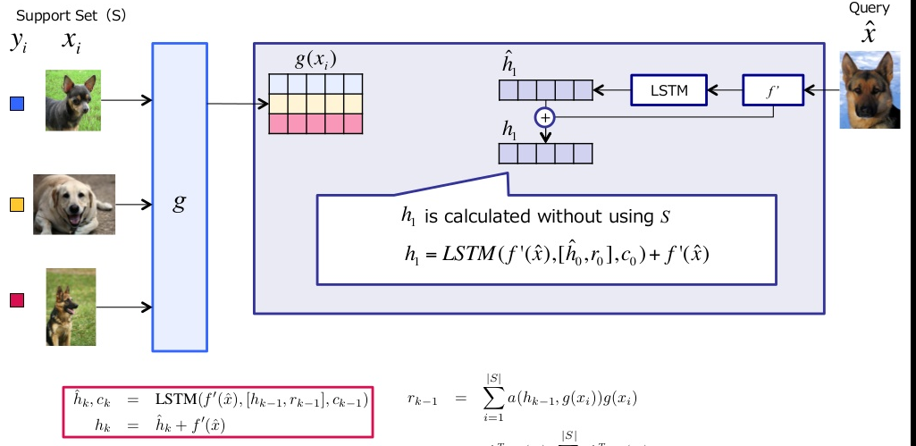

Slide 9
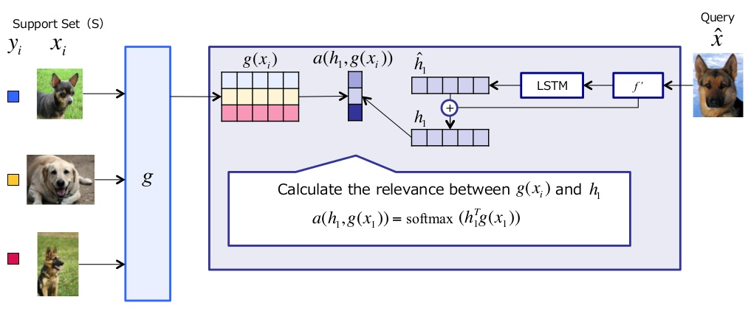

Slide 10
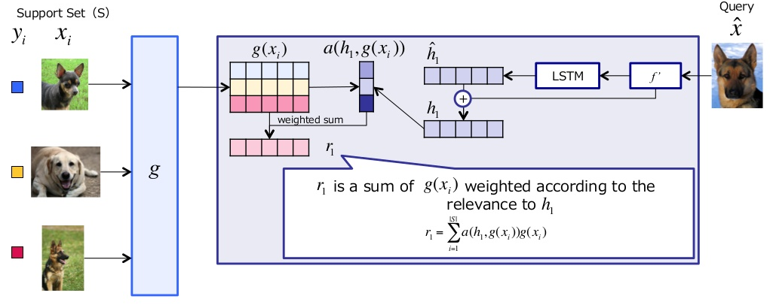

Slide 11
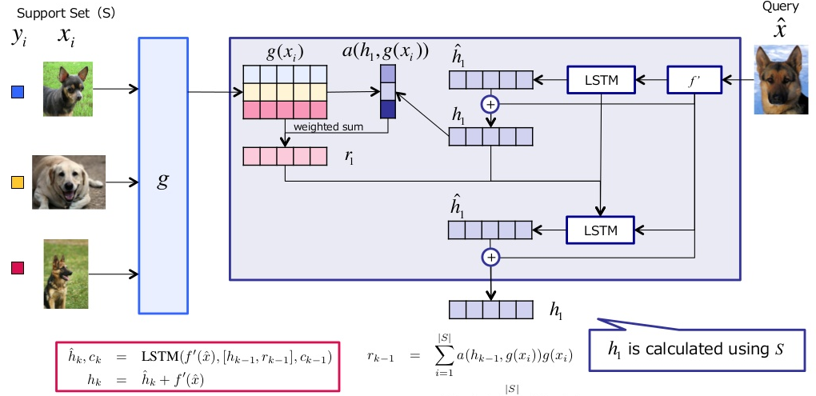

Slide 12
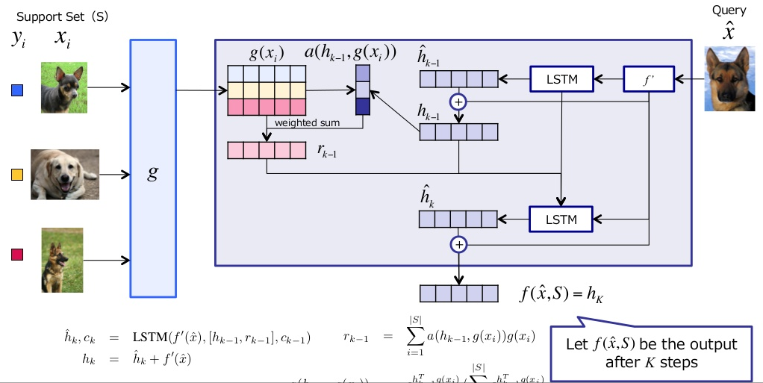

Slide 13
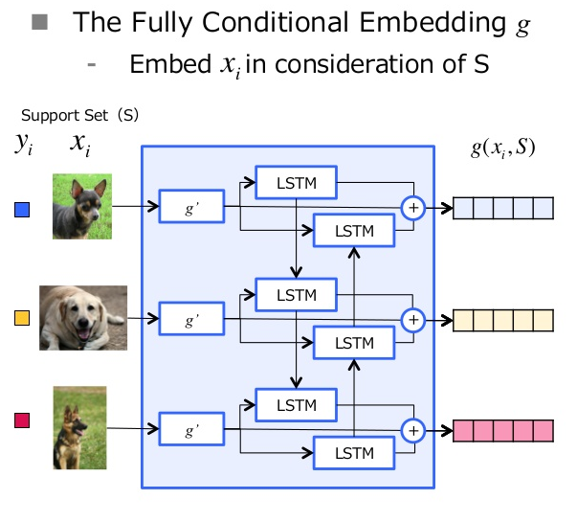
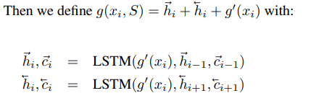

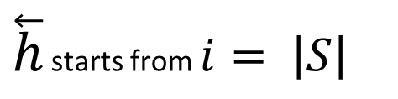
Full Context Embeddings $g$
$\overset{⃖}{h}$starts from $i= \left|S\right|$

Slide 14
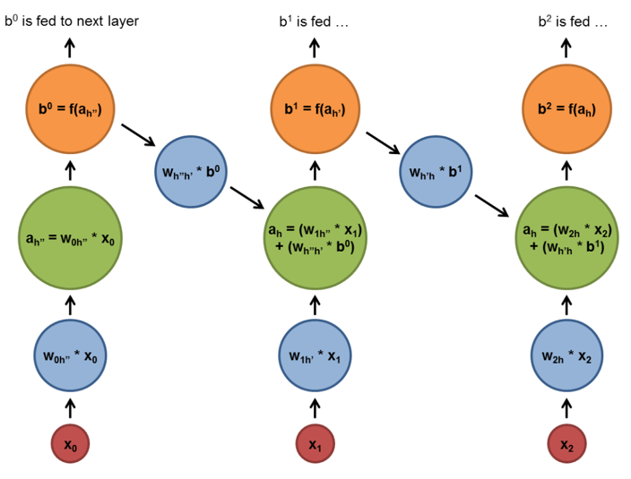
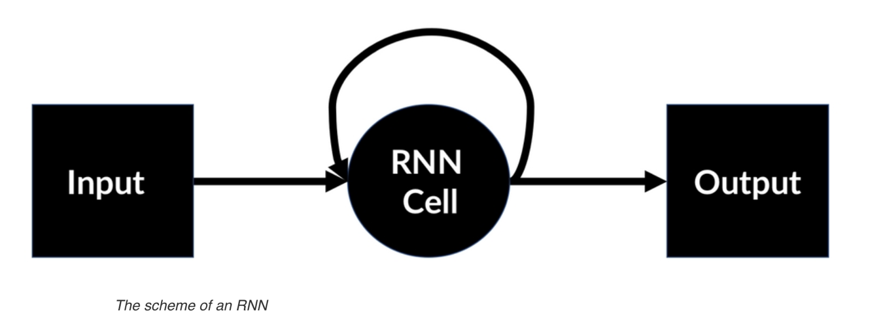

RNN

Slide 15
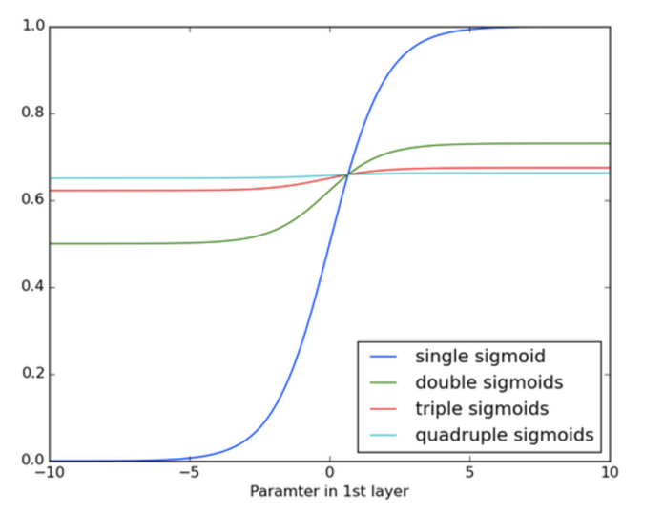
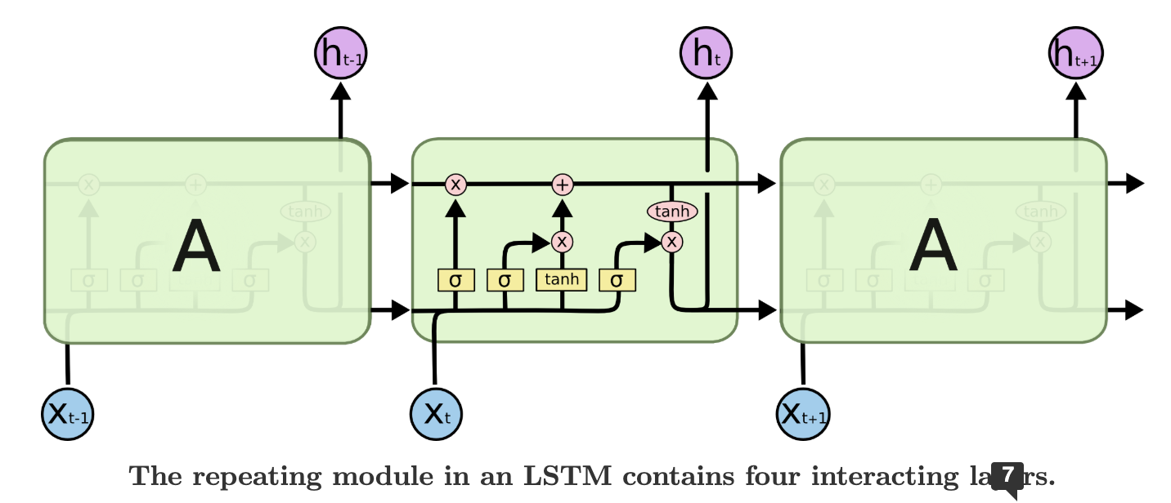
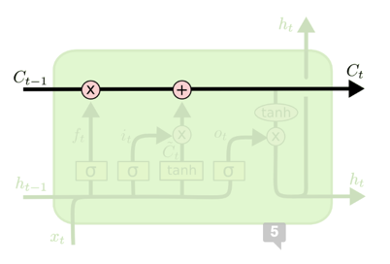
RNN LSTM
In direct response to the vanishing gradients problem of simple RNNs, the Long Short-Term Memory (LSTM) layer was invented. This layer performs much better at longer time series.

Slide 16
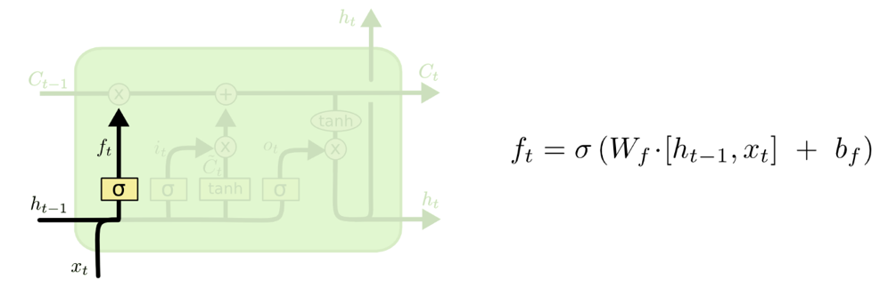
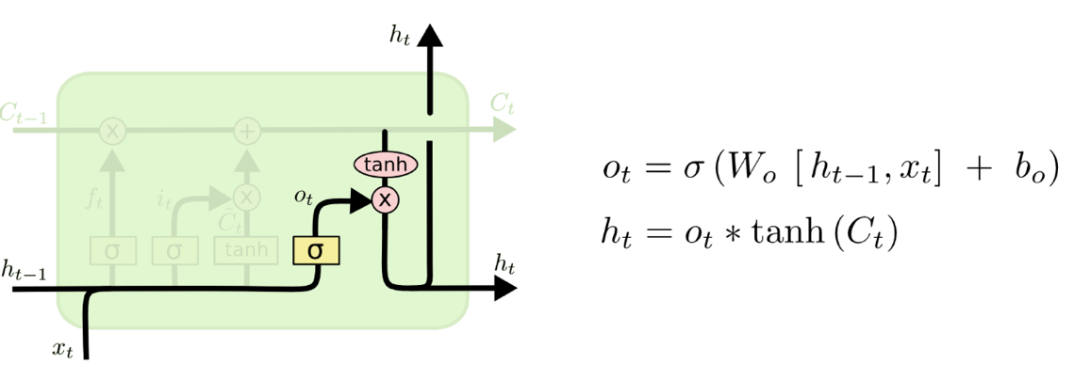
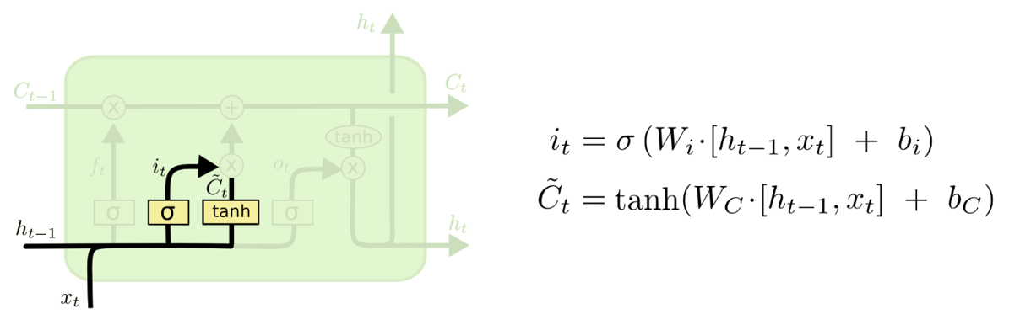
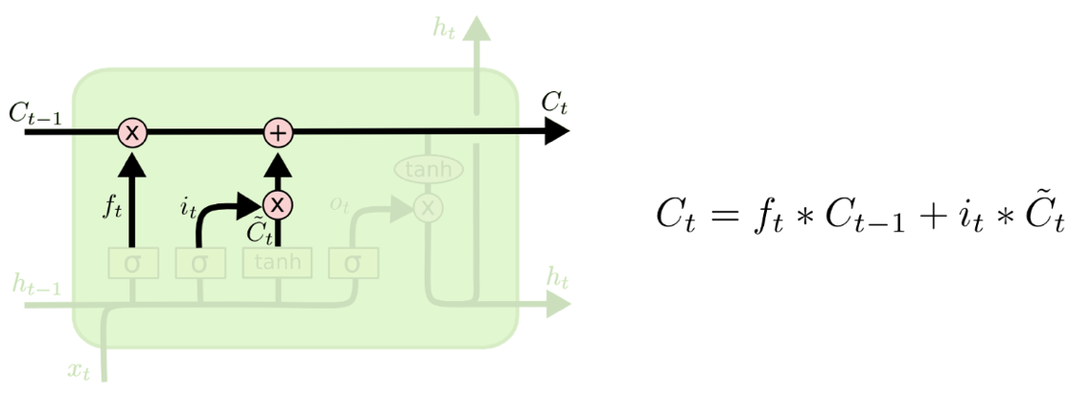

Slide 17

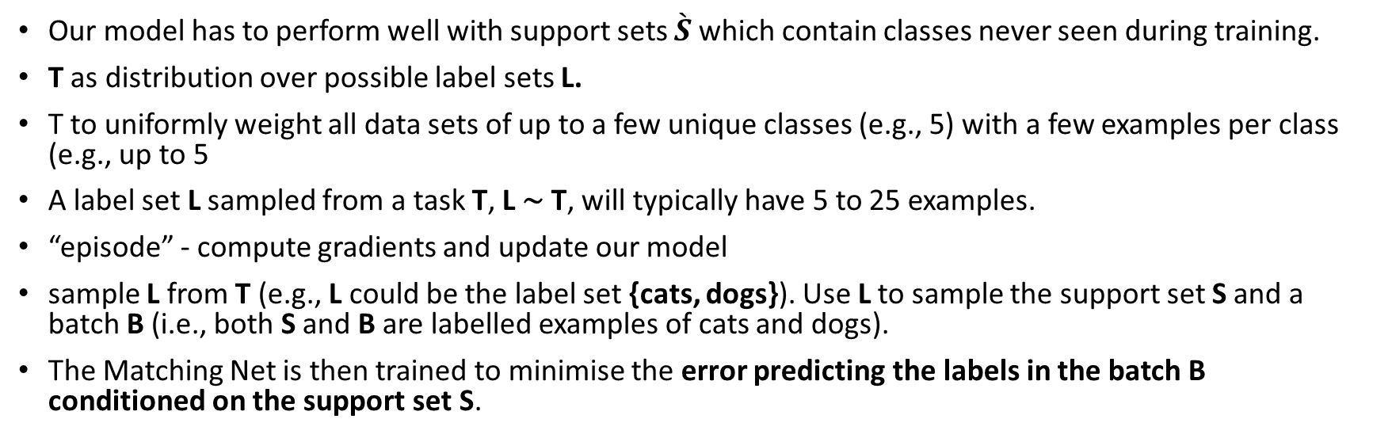
Training Strategy
Our model has to perform well with support sets $\grave{S}$ which contain classes never seen during training.
T as distribution over possible label sets L.
T to uniformly weight all data sets of up to a few unique classes (e.g., 5) with a few examples per class (e.g., up to 5
A label set L sampled from a task T, L ∼ T, will typically have 5 to 25 examples.
“episode” - compute gradients and update our model
sample L from T (e.g., L could be the label set {cats, dogs}). Use L to sample the support set S and a batch B (i.e., both S and B are labelled examples of cats and dogs).
The Matching Net is then trained to minimise the error predicting the labels in the batch B conditioned on the support set S.

Slide 18
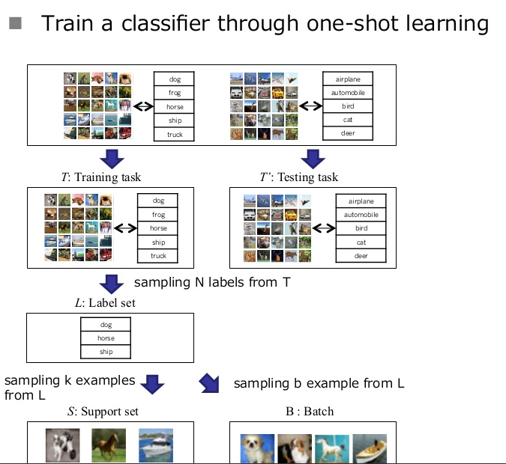

Slide 20
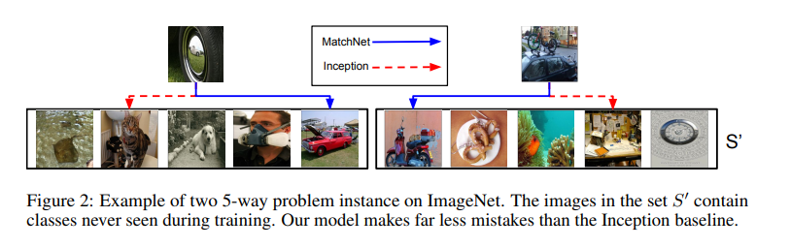
Results

Slide 21
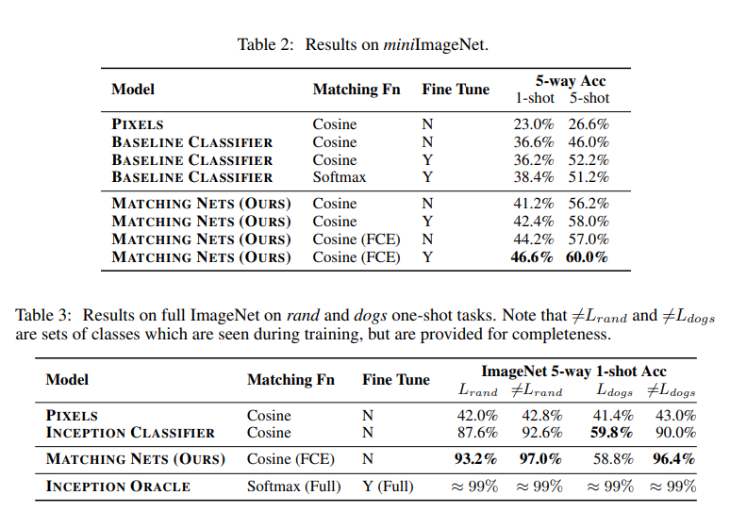

Slide 22
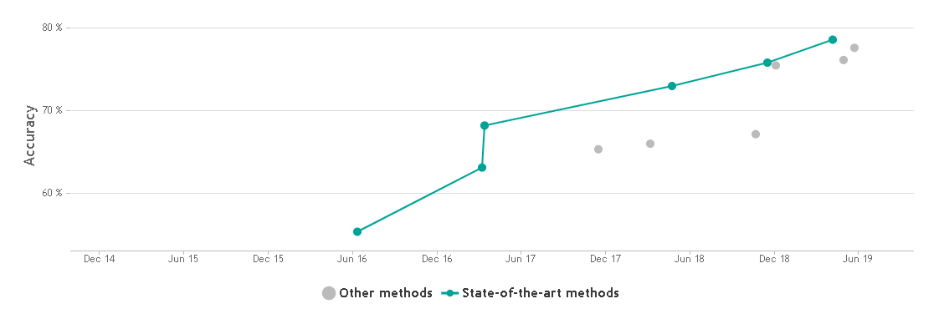
78,6 % MetaOptNet-SVM
$$53,3 \%\text{Matching} \text{Nets}\text{ + }\text{C}\text{64}\text{F} \text{feature} \text{extractor}$$

Slide 23
Codigo
https://github.com/AntreasAntoniou/MatchingNetworks

